Slide 1
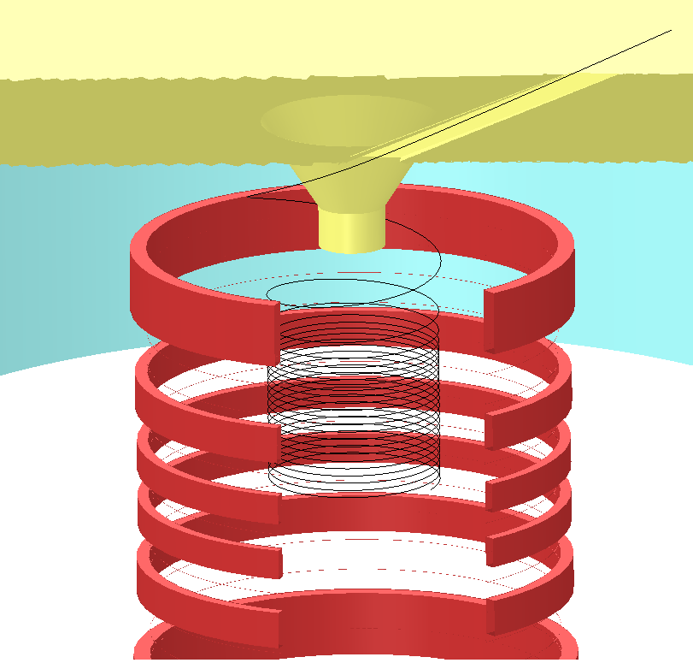
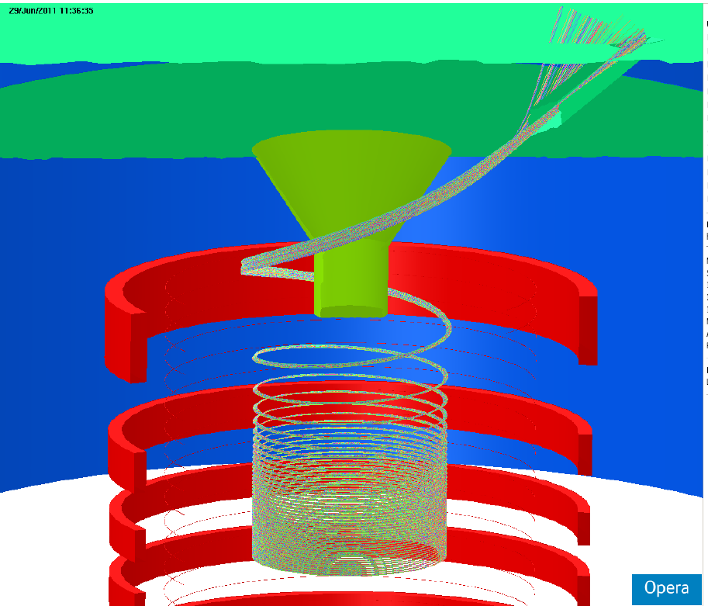
Injection and Kicker
2010 Dec
A single μ⁺
Contents:
Two updates and one new activity
spiral Injection study
Kicker study updates
Weak focus and Spin tracking (new!)
Now: 2011 June
631 μ⁺
2011/06/30
Hiromi Iinuma for SIT48
Spiral Injection Team
SIT48

Slide 2
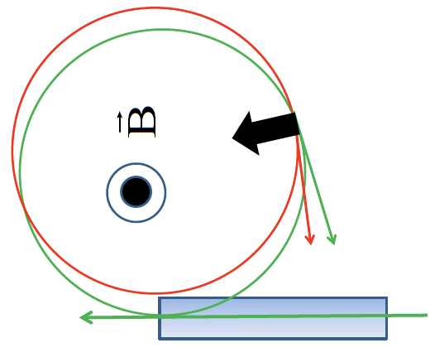
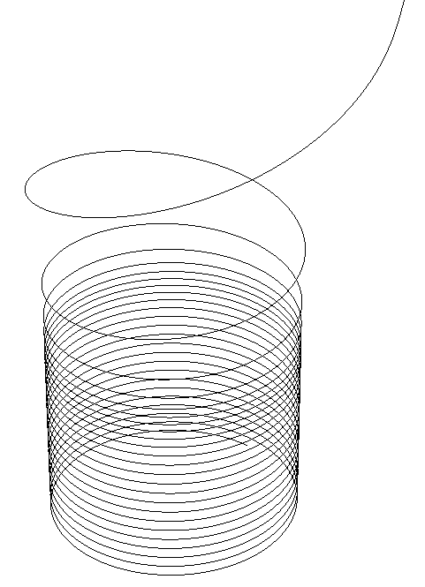
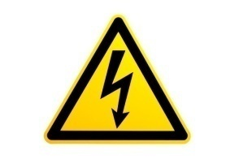
Brief review of Spiral Injection
66cm
Technical difficulties:
3T is too high to cancel fringe field by inflector,
Required kick angle (~60 mrad) is too big.
7.4nsec
No effect on the storage field!!
Spiral trajectory
Spiral trajectory
Inflector
Apply proper radial fringe field to bend(or deflect) vertical motion to the horizontal
μ⁺
2-D orbit
Vertical Kick
Beam storage plane
Storage plane
Notes:
We do not apply horizontal beam injection.
Because of technical……
Instead of horizontal injection, we try 3D spiral Injection Scheme:
Long axis field, like a solenoid, is needed.
We make use of radial fringe field to deflect vertical motion to horizontal.
And then, we apply vertical soft kick to "stop" the vertical motion completely in the storage region

Slide 3
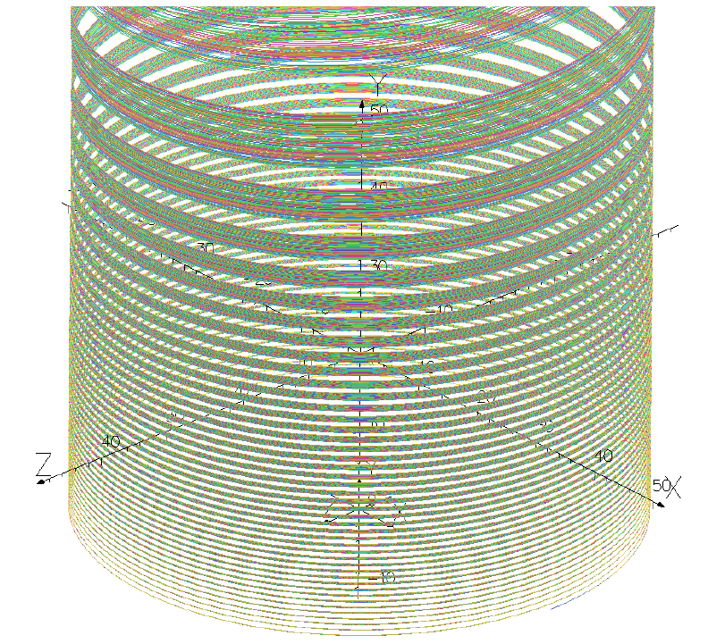
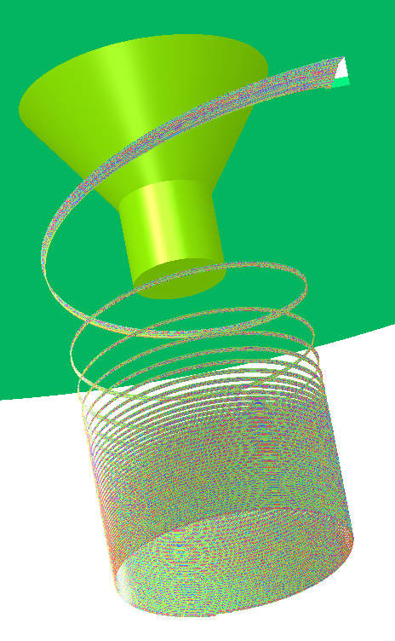
How to find a trajectory for a bunch of muons?
Try inverse beam!
Y
tunnel
z
x
Start
Y-axis
631 μ⁺
X-Zplane
2R=66cm
Δθ
ΔR
Start
Y-axis
Y-axis
Base trajectory plus 4 parameters
ΔR=±20mm
Δθ=±0.3rad
Δy= ± 2mm
ΔVy/Vy= ± 3E-3 (~ ± 10μrad)
Δy
ΔVy/Vy
X-Zplane
Notes:
Start with base trajectory which is shown in the first page, I try 4 parameters
Radial, angle along the orbit, vertical position y and vertical angle

Slide 4
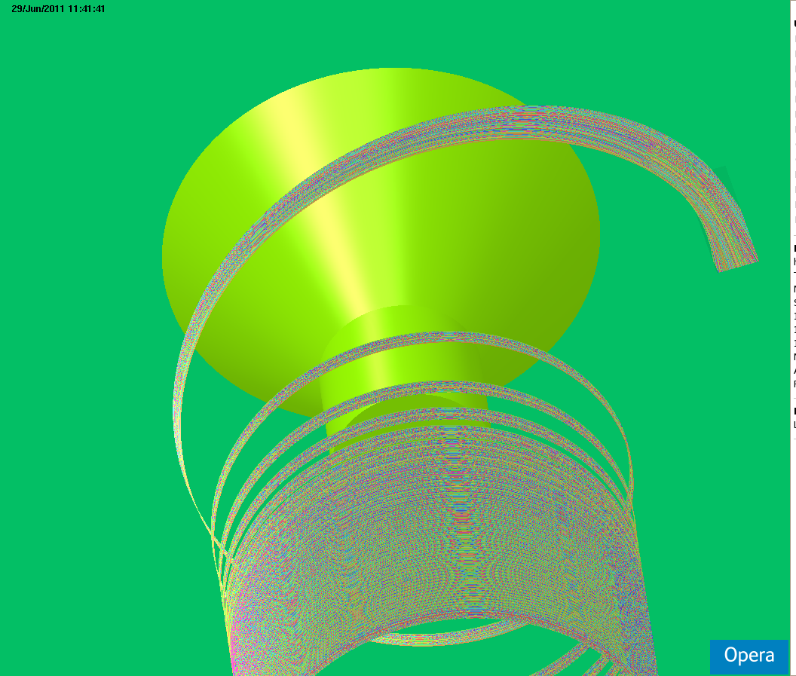
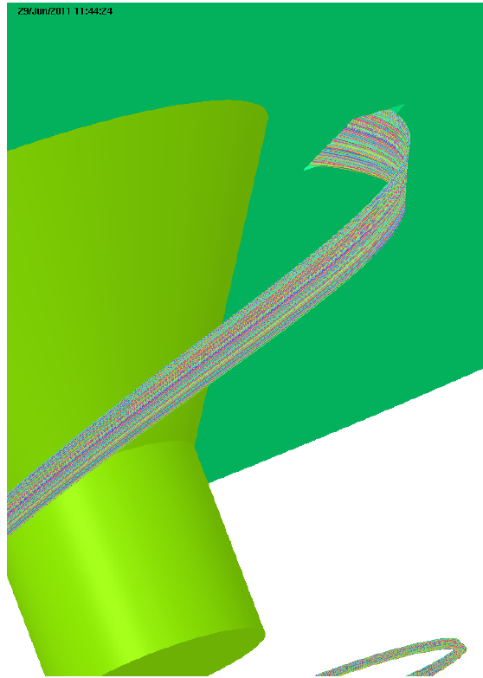
More pictures!
631 μ⁺
tunnel
tunnel

Slide 5
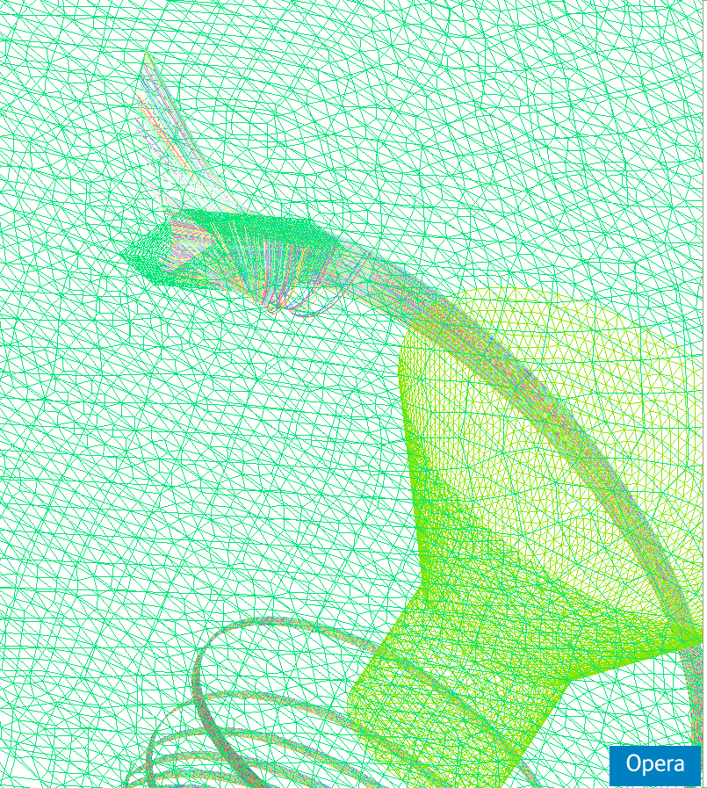
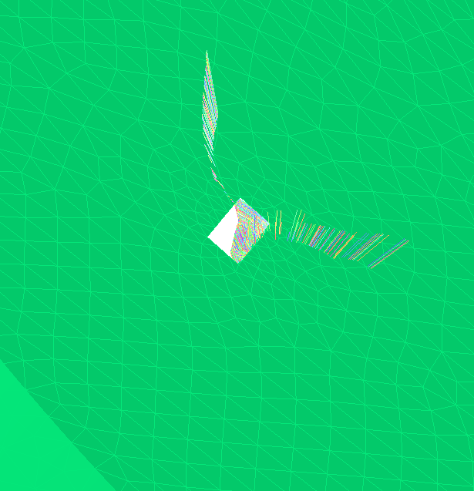
How about the other side?
631 μ⁺
Majority is good!
Straight tunnel does work!
Need to work a bit for tunnel cross-section?

Slide 6
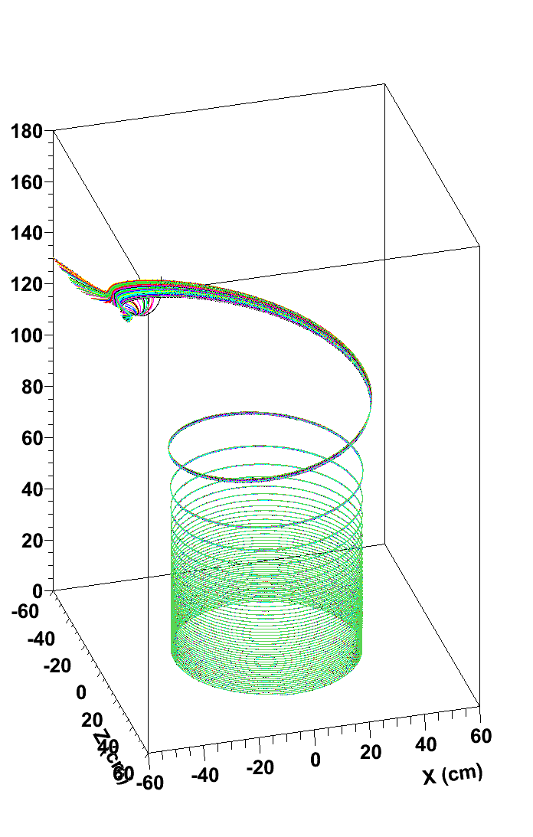
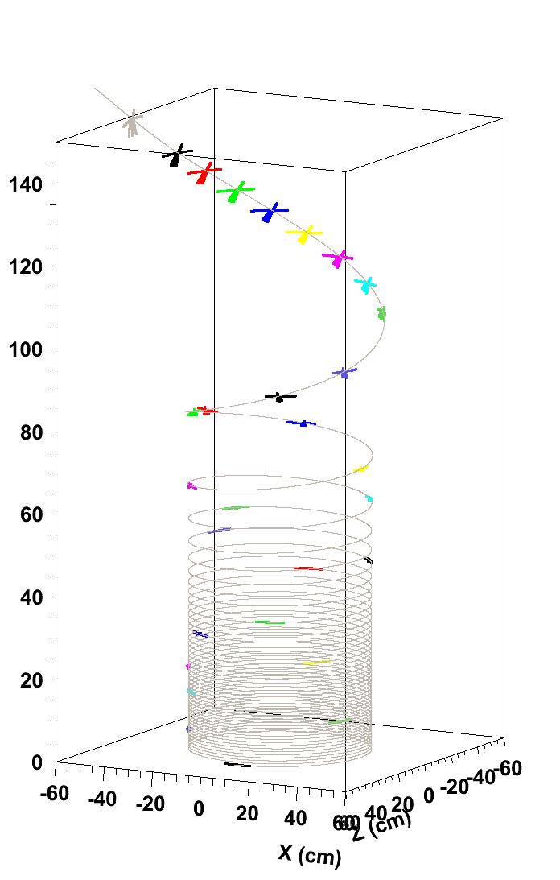
Slice basic trajectory and get step numbers (=time) at Y=150cm, 145cm,……0cm
Solenoid field
→A big focusing field
Δy, ΔVy
Δθ
ΔR
Base trajectory plus…
Δy= ± 2mm, ΔVy/Vy= ± 3E-3 (~ ± 10μrad)
ΔR=±20mm, Δθ=±0.3rad

Slide 7
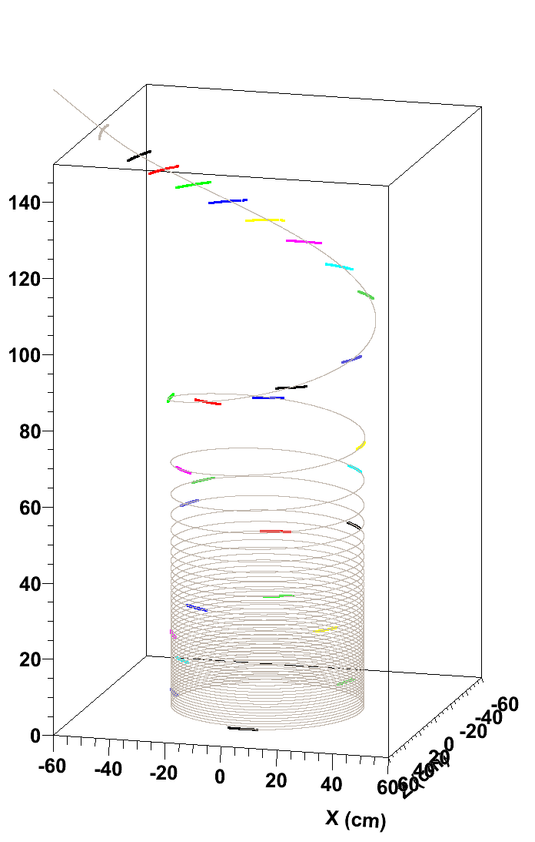
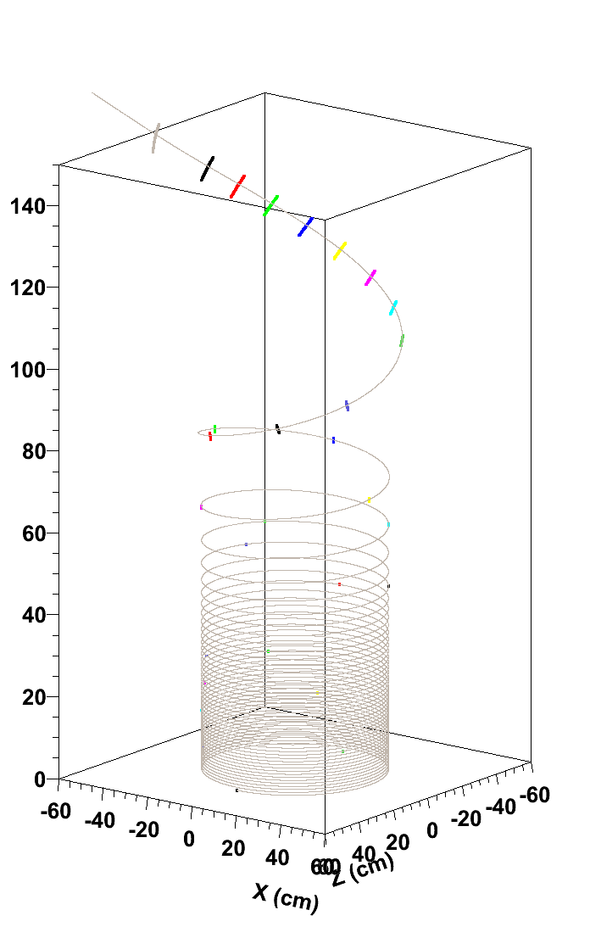
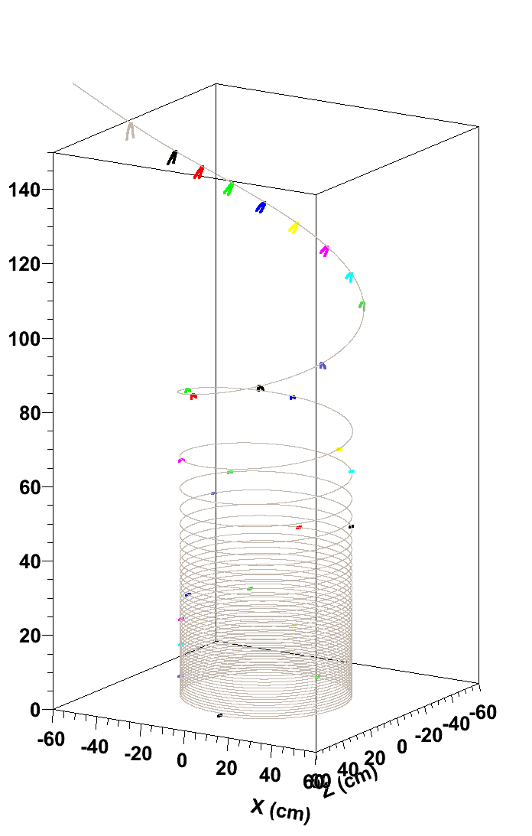
Sliced trajectories by step number (=time)
Δθ
Δy, ΔVy
ΔR
Base trajectory plus…
Δθ=±0.3rad
Base trajectory plus…
Δy= ± 2mm
ΔVy/Vy= ± 3E-3 (~ ± 10μrad)
Base trajectory plus…
ΔR=±20mm

Slide 8
Next step for beam injection study
Study fine slices inside a tunnel: 145 < y <180cm
Straight but cone shape tunnel?
Estimate emittance in the field “free” space (y>=150cm) and pass parameters to LINAC team
150cm
145cm

Slide 9
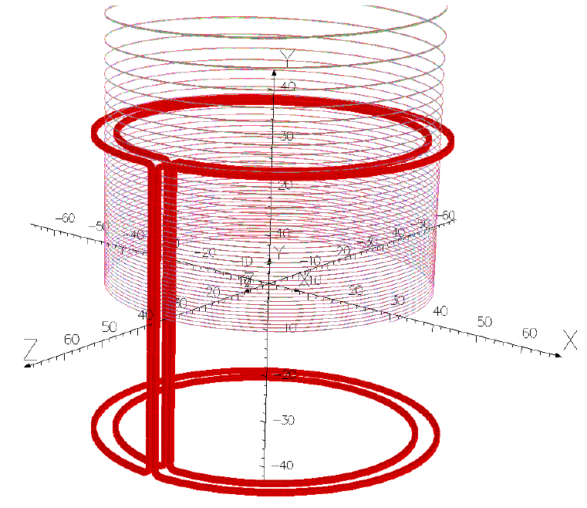
Kicker update
Stop the vertical motion by pulsed radial field
2-D orbit
Vertical Kick
Beam storage plane
Storage plane
Radial magnetic field ;Br=B₀sinω_{kick}t
T_{kick}/2= ~150nsec
Peak field B₀=1.5 gauss

Slide 10
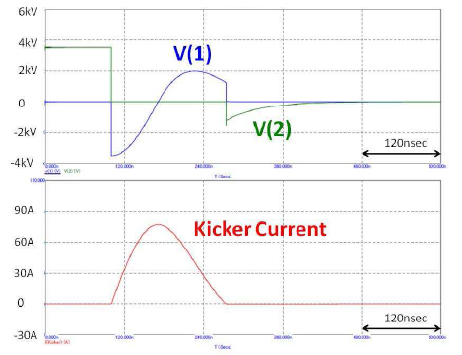
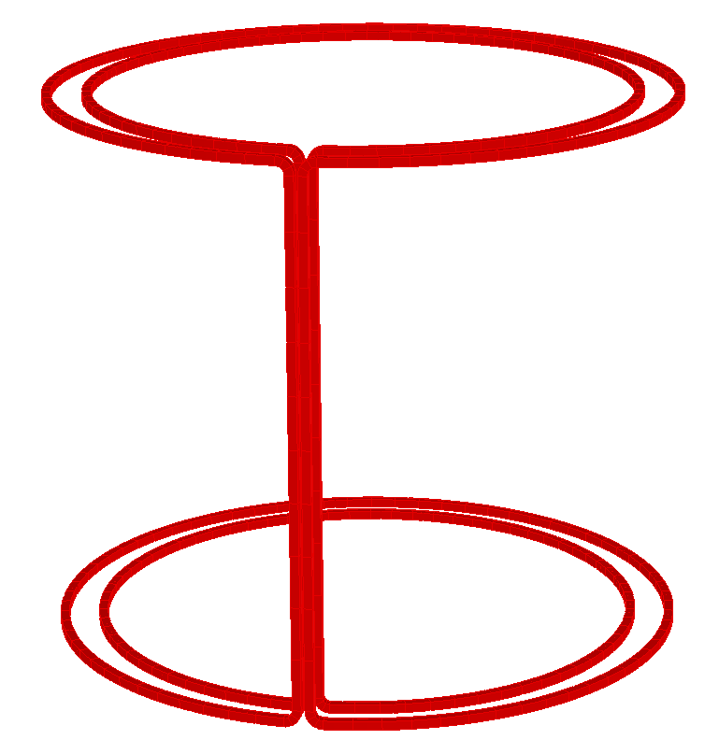
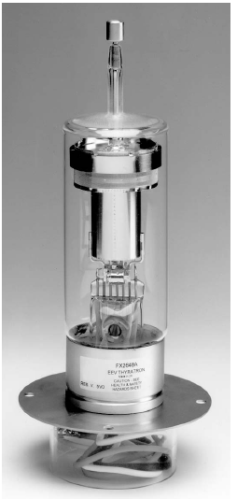
Prototype kicker is ready by the end of July!
Already bought and my grant for this year is gone…
Borrow from Nakayama-san’s friend
Hand-made dummy coil for this year
+15kV
1nF
10W
+15kV DC
1MΩ
3μH
Buy it in the next year
Buy it in the next year
Hydrogen Thyratron (FX2648A)
Half-sin shape peak~75A
Height±31cm
R=30.75,35.25cm
Two pairs of single turn coil
5mmφpipe

Slide 11
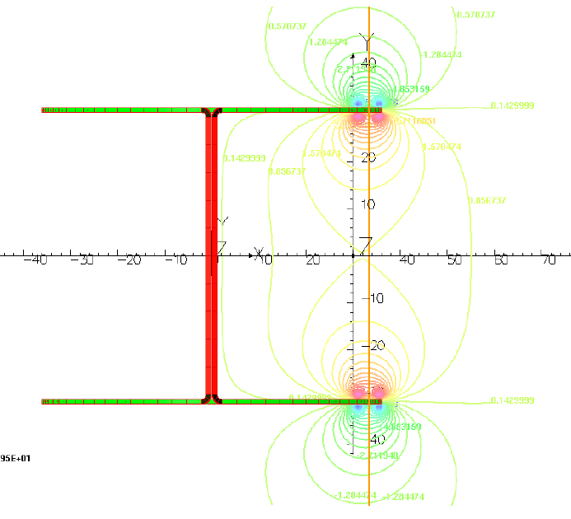
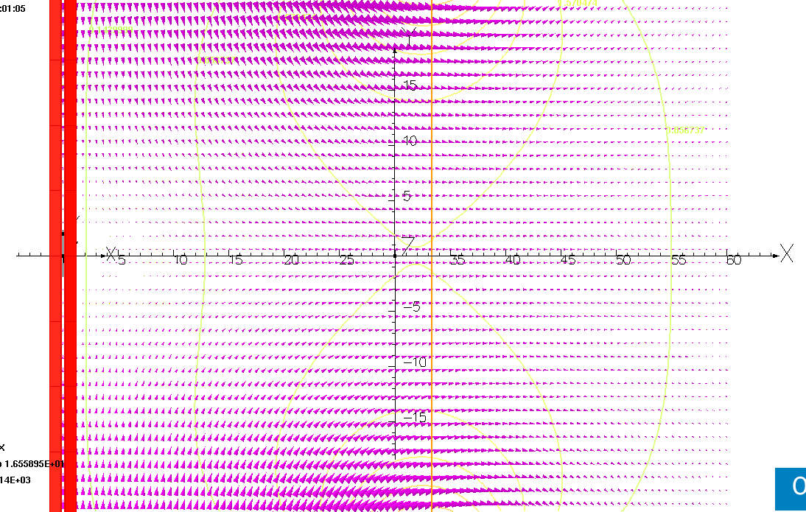
Kicker field
Radial component ;
Br=B₀sinω_{kick}t
T_{kick}/2~150nsec
Peak field B₀=1.5 gauss

Slide 12
Activities for second half of 2011
1. Confirm the concept!!
Spiral trajectory
Test experiment with small normal solenoid magnet and low energy electron beam by electron-gun.
Apply proper radial fringe field to bend(or deflect) vertical motion to the horizontal
μ⁺
2-D orbit
Vertical Kick
Beam storage plane
Storage plane
2. One path motion is OK. But…
How to store a beam in uniform field?

Slide 13
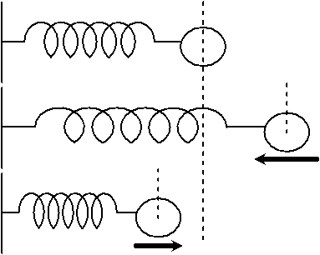
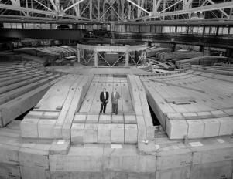
Need weak focus in the storage area!
Unique field with tune=1 is unstable!
→Tiny field error can spread the beam!
Focusing beam horizontally and vertical y at a time by a single unit
I learned from Oide-san recently…
Only weak focusing system does work!
The Bevatron was a historic particle accelerator — specifically, a weak-focusing proton synchrotron — at Lawrence Berkeley National Laboratory which began operating in 1954.
Focus condition 0<n<1
n<1: for radial direction
n>0 :solenoid axis direction
http://en.wikipedia.org/wiki/Bevatron

Slide 14
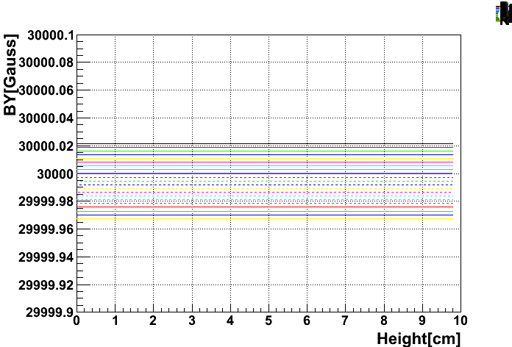
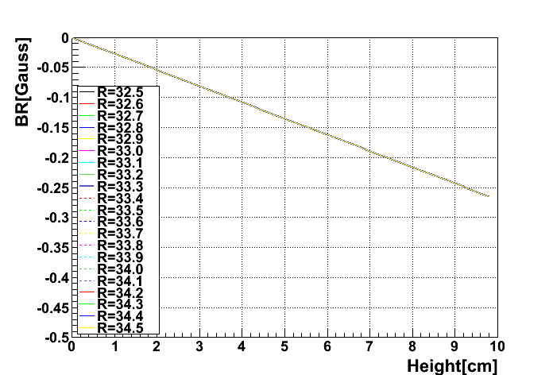
How much field is needed?
n=3E-5
If we require:
ΔR
n<1: for radial direction
n>0 :solenoid axis direction
n~3E-5 fits our case
y

Slide 15
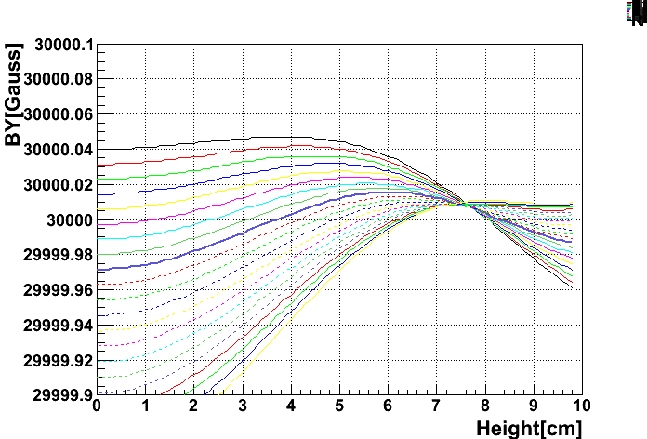
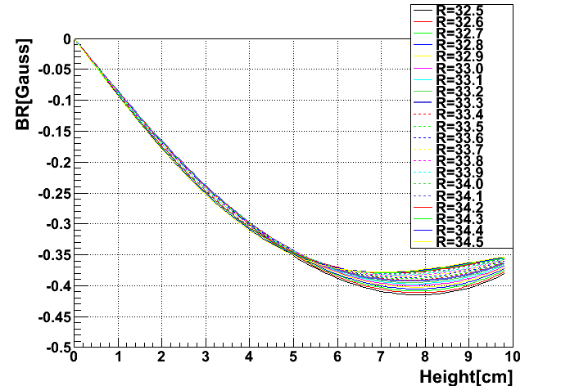
How much field is needed?
Simulated sample field
If we require:
R=33.3cm
Weak field design is ongoing and…

Slide 16
New activity
Storage the beam for ~33μsec → 4400 turns.
No one path solution anymore! (different from injection and kicker).
Should not use integration (numerical) approach only.
Analytical approach to get averaged orbit, momentum and spin is important!
Prof. Forest joins us and start spin tracking.
Now, I am a trainee for beam storage.
Thank you!

Slide 17
backup

Slide 18
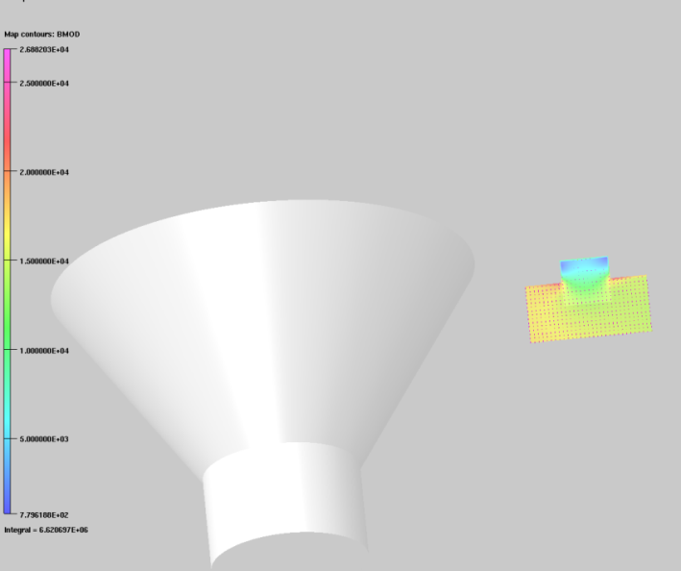
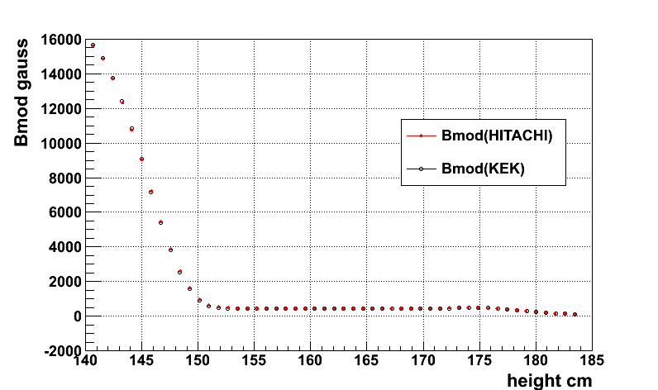
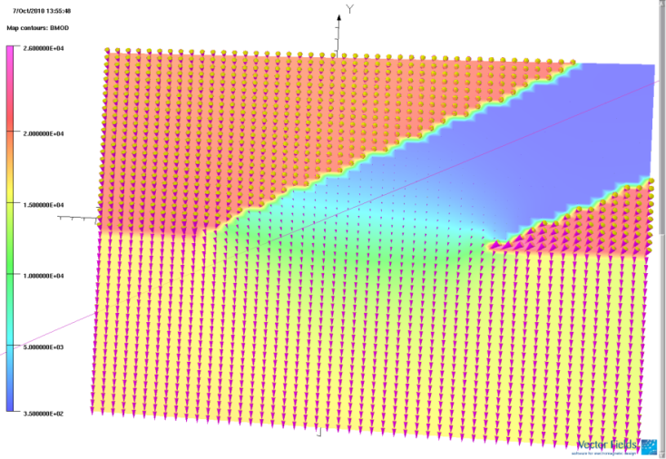
Field inside beam tunnel
Tunnel fro inside
Inside tunnel
Outside
OPERA 3D
Straight tunnel does work!

Slide 19
Spin equation (T-BMT equation + EDM)
Our case:

Slide 20
How to control the beam into the storage region and how to keep it?
Vertical Kick by dynamic radial field

Slide 21
How to get peak field of kick?
Longitudinal muon velocity “vL=const” at good field region
B_{R}(R,z)=17693.302×θ_{kick}×ω (gauss)
Ex. θ_{kick}= 5mrad, p_{z0}=1.5MeV/c,
T/2=150nsec stop
B_{R}(R,z)= 1.9 gauss
(Unique spatial distribution is ideal)

Slide 22
How much (vertical) volume, which has an unique spatial B_{R} distribution, with a given kick time period?
at t >t₀
ex. p_{z0}=1.5 MeV/c, T=300nsec (150nsec stop), wee need vertical volume Z₀=10.6cm

Slide 23
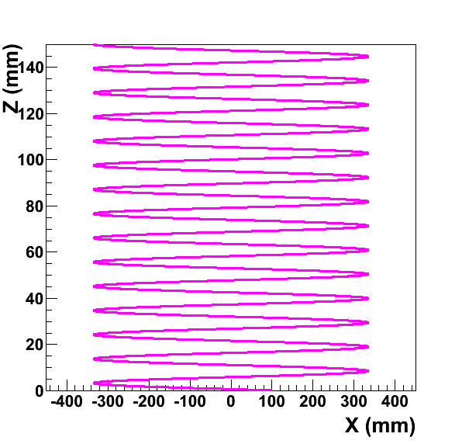
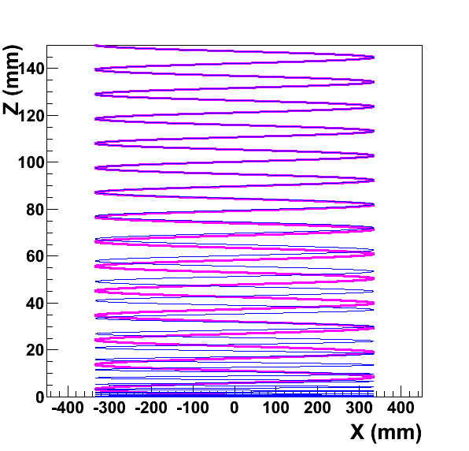
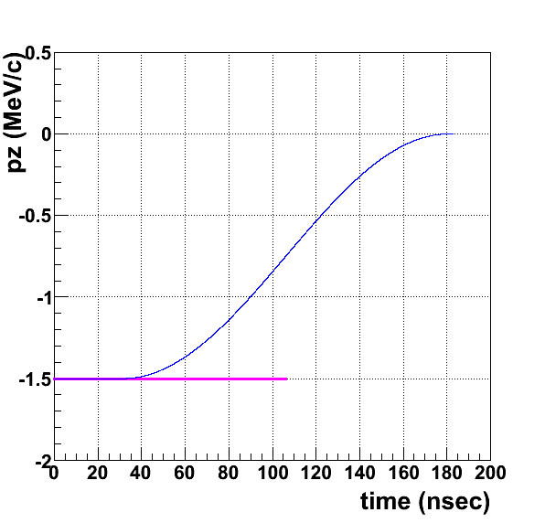
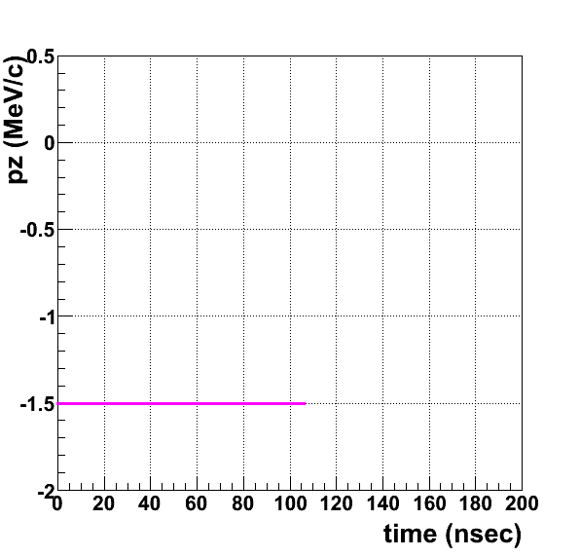
Analytic approach and simulation are consistent
Scale for vertical and horizontal are not same
T/2=150 nsec kick
vertical volume Z₀=10.6cm
150nsec (half period)
No kick,
No change of vertical momentum ;pz

Slide 24
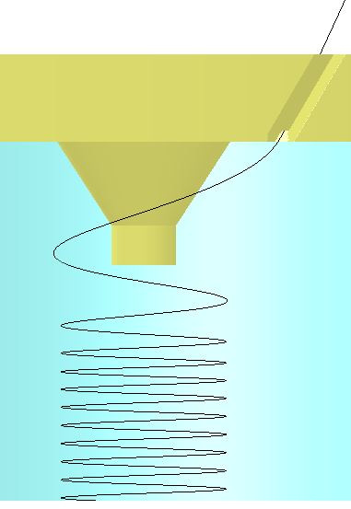
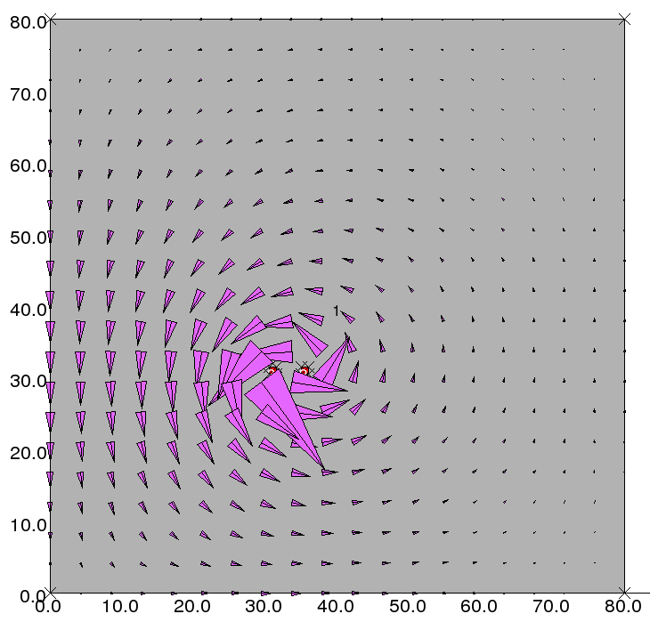
Vertical kicker (ver.1)
Rounded dipole type
Br(t)=B_{peak} ×sin(ωt)
OPERA 2D
Coils
30cm
Br(t)
Do not interfere with detector/vacuum chamber
Prototype kicker is being designed for test soon!

Slide 25
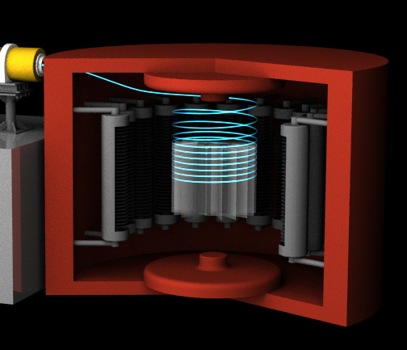
Requirements for Kicker
Br(t)=B_{peak} ×sin(ωt)
ω=π/Tkick
Field strength：
Bpeak = 1Gauss ~ 10 Gauss
Time distribution：
Tkick=150 nsec (c.f. 20 cyclotron periods)
Spatial distribution：
33cm±5mm in radial direction, good uniformity (better than 1%)
±10cm(~ ±30cm?) in solenoid axis direction to reduce
beam bunch shape
Possible sources for field distortion:
Eddy currents on cryostat wall
Peak field reduction by cryo. wall
Minimal effect for positron detector：
Quench protection
Space problem
e⁺ detector
(Silicon tracker)

Slide 26
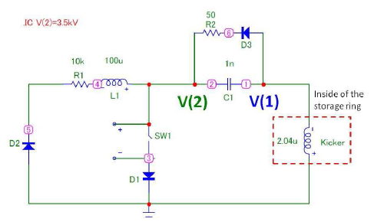
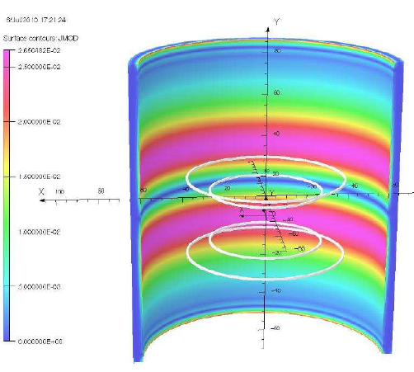
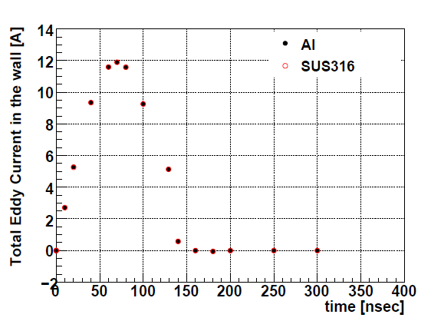
Kicker circuit and eddy current study
R=60cm cryostat wall
Start DAQ

Slide 27
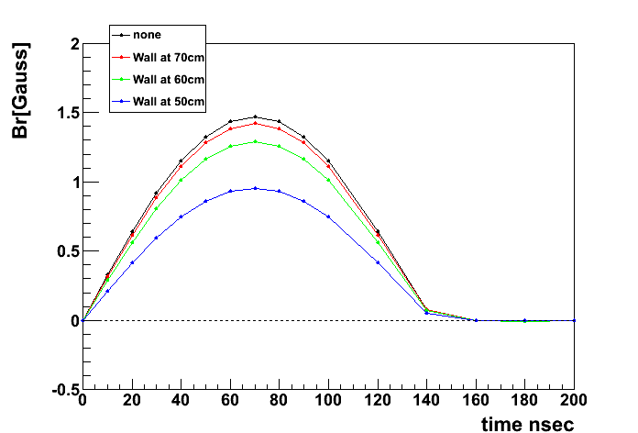
Ver.1 type Kick field @r=33.3cm
Peak field reduction by cryo. wall
0.967
0.878
0.649
Minimum distance?
Eddy currents on cryostat wall
∼mgauss
Br(t)=B_{peak} ×sin(ωt)
round_d-12_tr
round_d-12_wall-1,2,3_tr

Slide 28
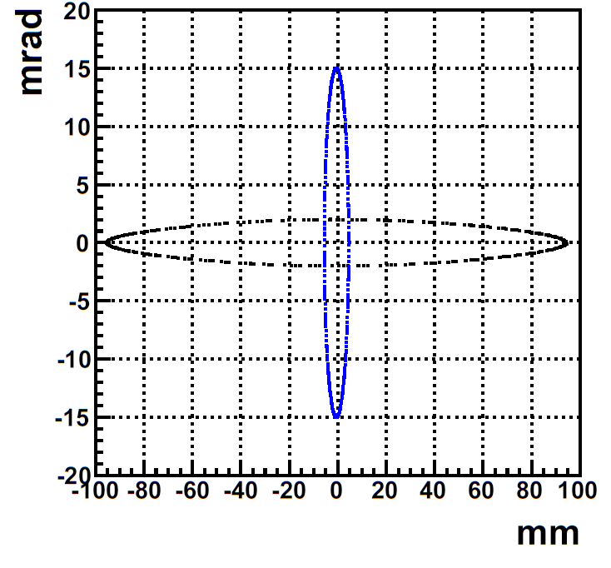
Acceptable beam parameters for sample weak field
Use GEANT4 (numerical approach) Satisfy Δω/ω<0.1ppm
radial 5mm-15mrad
vertical 90mm-2mrad

